Slide 1

The Unstoppable You: Building Discipline & Confidence
Welcome to a journey of self-mastery. This presentation offers practical, actionable guidance to cultivate unwavering discipline, boost your confidence, and unlock your full productive potential. It's time to build the unstoppable you.

Slide 2


Stage 1: Silently Grow
Cultivate a Winner's Mindset
Break free from your comfort zone. Embrace challenges as opportunities to become unstoppable. Every small step forward builds momentum.
Embrace Discomfort
Start your day with a cold shower to train mental resilience and build tolerance for discomfort. It's a powerful way to awaken your senses.
To truly grow, you must first commit to the process, often in quiet, deliberate steps.

Slide 3
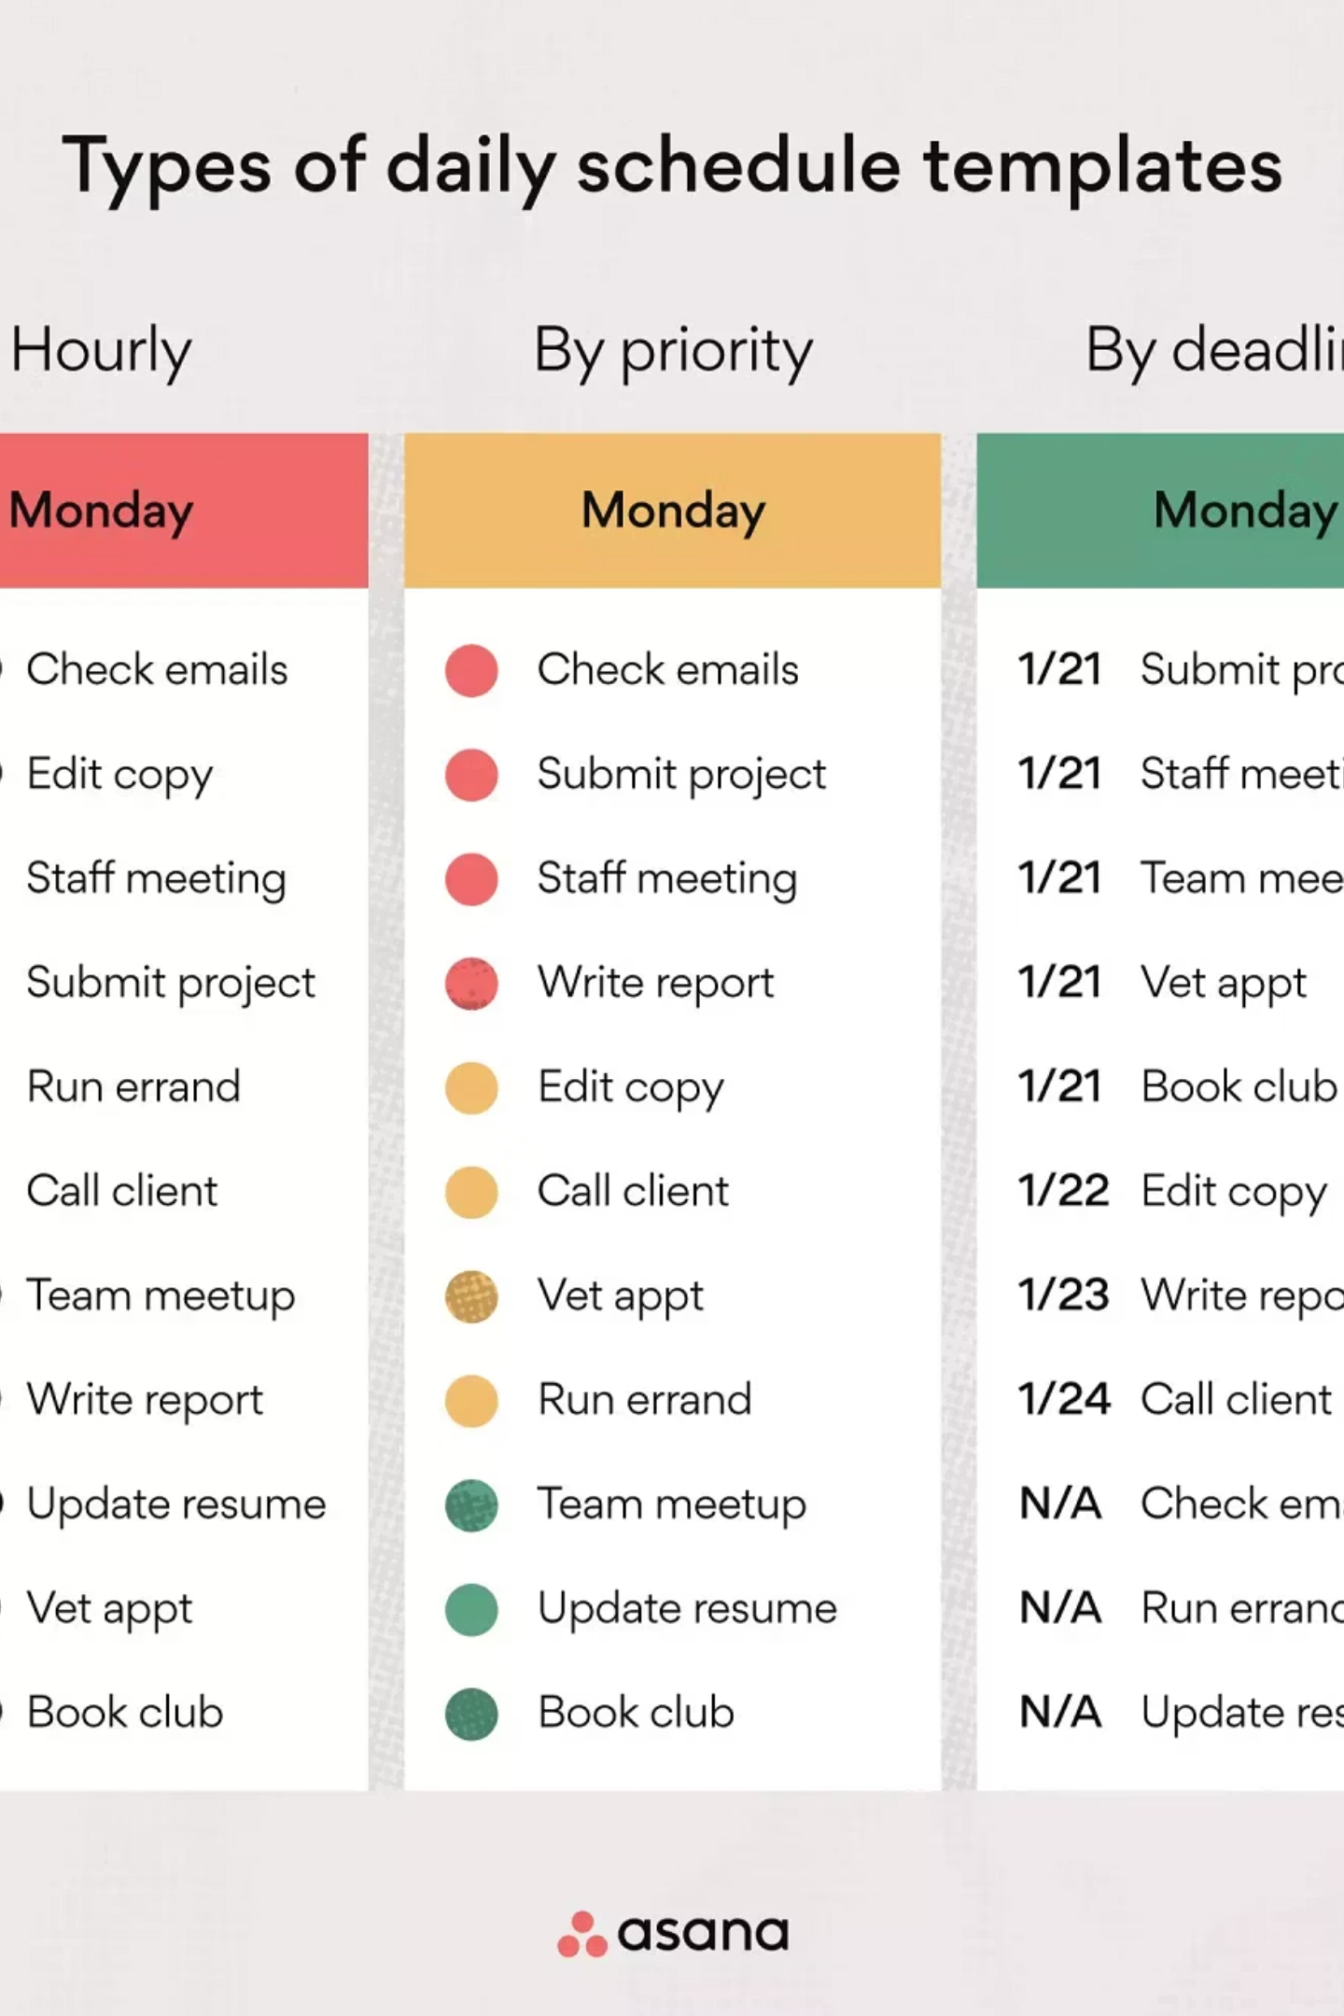
Stage 1: Daily Rituals for Growth
Strategic Scheduling
Prioritise Exercise
Dedicate blocks of pure focus to developing important skills. Eliminate distractions during these crucial periods.
Regular physical activity is vital for a strong body and a sharp mind. Make it a non-negotiable part of your routine.
Confront Insecurity
Address your insecurities head-on. Unaddressed, they can lead to low focus, anxiety, and depression.

Slide 4

Stage 1: Conquering Insecurity
Insecurities can hold you back. Identify them and create a plan to overcome them.
Body Insecurity
Engage in regular physical activity. A strong body builds confidence.
Communication Skills
Practice active listening and public speaking. Confidence comes from preparation.
Professional Doubts
Project confidence and continuously seek knowledge to excel in your field.
Innate Insecurities
Some things are difficult to change. Accept them and empower yourself through your unique strengths.

Slide 5

Stage 1: Mind-Body Connection
Your physical presence and mental state are intrinsically linked. Work on both to achieve holistic strength.
Confident Body Language
Walk with purpose, maintain eye contact, and use open gestures. Your posture communicates volumes.
Strong Mind, Strong Thoughts
Nurture a positive mental environment. Engage in meditation and affirmations to foster positive thinking.

Slide 6




Stage 2: Overcoming Laziness & Procrastination
Even with the best plans, laziness can creep in. Parkinson's Law provides a powerful strategy to combat it.
"Work expands to fill the time available for its completion." – Parkinson's Law
Time Pressure
If you allocate two hours for a task, it will take two hours. If you allow a week, it will take a week.
Hyperfocus Mode
Just like exam preparation, where you achieve immense focus, apply artificial deadlines to daily tasks.
Daily Application
Use this principle every day to maximise productivity and avoid time wastage.

Slide 7
Stage 2: Practical Application of Parkinson's Law
Implement these steps to harness the power of focused work:
01
02
03
Set a 90-Minute Timer
Eliminate Distractions
Maintain Focus
Commit to 90 minutes of uninterrupted work. This focused block is incredibly effective.
Turn off your phone and close unnecessary tabs. Create an environment conducive to deep work.
If your mind wanders, take a brief physical break – do a few push-ups to reset.
04
05
Avoid High Dopamine Activities
Nourish Your Body
Steer clear of social media reels and other "cheap dopamine" sources that kill focus and waste hours.
A healthy diet fuels a healthy mind. Avoid junk food and choose nutritious options.

Slide 8
Stage 3: Starting & Sustaining Momentum
"Tomorrow never comes" when faced with daunting tasks. The key is to make starting easy.
Break Down Tasks
1
Don't think of a 4-hour paragraph; aim for 40 words in 2 minutes. Small wins build momentum.
Short & Easy Starts
2
If a goal seems too big (e.g., running 1 mile), start with a fraction (half a mile). Build gradually.
Don't Rely Solely on Willpower
3
Use external cues to remind yourself, like placing healthy snacks within reach for dietary goals.
Consistency over Perfection
4
The goal is to show up every day, not to be perfect every time. Consistency leads to mastery.

Slide 9


Stage 4 & 5: Continuous Improvement & Navigating Challenges
The path to an unstoppable self requires unwavering commitment and resilience.
Stage 4: Everyday Improvement
Stage 5: Clear Direction & Resilience
Commit to being better than you were yesterday. Small, consistent improvements compound over time, leading to significant personal growth.
Know your direction and stay focused. Others may try to deter you or cause pain, but maintain your composure and smile.
Even if friends drift away, remain focused on your journey. Your growth is your priority.

Slide 10

Stage 6: The Unstoppable You Emerges
You've embraced challenges, built discipline, and fostered an unbreakable mindset. Now, you stand in a league of your own.
Fear Transformed
Those who once doubted your strength will now hesitate to compare themselves to your progress.
Inner Strength
Your consistent efforts have forged an inner resilience that commands respect and confidence.
Continue to grow, continue to challenge yourself, and remain the unstoppable force you have become.

